Slide 1
Recommendations of Office Application and Computer Hardware
Name:
Professor:
Course:
Date:

Slide 2
Overview
Recommendations of office applications
Recommendations of hardware
Setting goals and priorities
Schedule of project and expected time of completion
Identification of potential issues and initial risk assessment
Notes:
This slide highlights the contents of the presentation. The presentation provides recommendations of office applications and hardware that will be used for the project.

Slide 3
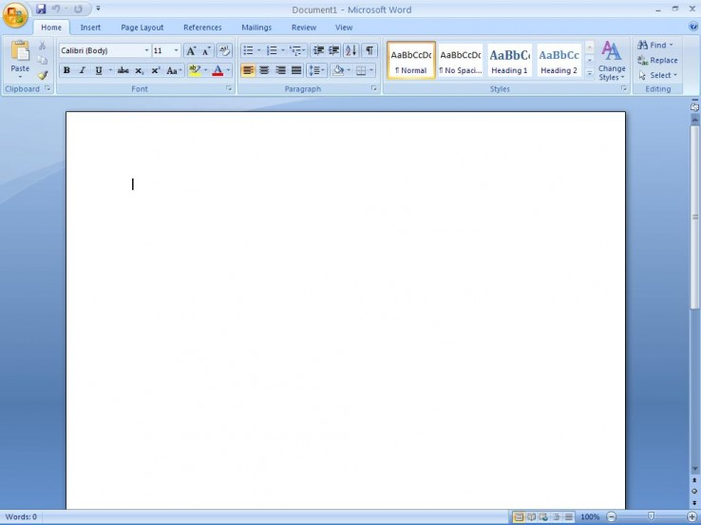
Recommendation of Office Applications
Recommended office applications include,
Microsoft Office Word
Microsoft Office Excel
Microsoft Office PowerPoint
Microsoft Office Outlook
Microsoft Office Access
Notes:
Different office applications will be used for this project. Applications which will be regularly used during the project include Microsoft Office Word, Microsoft Office Excel, Microsoft Office PowerPoint, Microsoft Office Outlook, and Microsoft Office Access.
Microsoft Office Word will be used to type the final document after the research to investigate effects of the Covid-19 pandemic on oil prices. Excel will be used to store data on oil price trends. PowerPoint will be used to make presentations (charts, tables, and incorporate them with text for better understanding. Outlook will be used to aid in task management to ensure that the project is on time. Access will be used for data storage and comparison of data from other applications.

Slide 4

Recommendation of Software
Windows 10 professional.
32-bit or 64-bit operating system
Microsoft office suite
Browsers
File transfers
Graphics
Mail
i-Sight case management software
Structured query language (SQL)
Python statistical programming
Data visualization
Notes:
Windows 10 professional will be the recommended windows edition with a 32-bit or 64-bit operating system. The preferred productivity software is Microsoft Office suite, which can be Office 365 Office ProPlus or Office 2019. Different browsers like Firefox, Safari, and Chrome will be installed.
Also, file exchange formats from text, graphics, video. Mail, and archives will be installed. Other applications that will be installed to promote optimal performance in the investigative office-based environment are i-Sight case management software, predictive analytics, structured query language (SQL), python statistical programming, and data visualization. These software are recommended because they will help in collection and analysis of data and the establishment of trends.

Slide 5
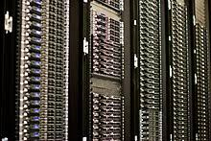
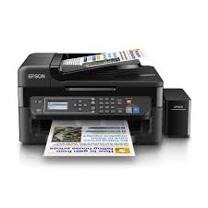
Recommendation of Hardware
Hardware will include,
  Desktop computers
  External hard drives
  Servers
  Printers
  Telephones
  Thumb drives
  Scanners
  Projector
  Power supply
  Heat sink
Notes:
The office will require several hardware for the completion of the project to be successful. Desktop computers, external hard drives, servers, printer, telephones, thumb drives, scanners, projector, power supply, and heat sink will be required in the office for operability to be achieved.

Slide 6
Setting goals and Priorities
Goals
  Develop a conducive investigative office-based environment e
  Install all hardware and software
  Connect o the internet
  Begin the class project
Priorities
  Set an office environment that promotes productivity and optimal performance
  Conduct the project within the scope
  Ensure that budget is followed
Notes:
While recommending the software and hardware that will be used for the project, it is necessary to highlight the goals and priorities of the project. Success in the project is depended on the ability to develop a conducive work environment that promotes efficiency, productivity, and performance. After developing the workplace, priorities will be set on how the project will be conducted. It will be a priority to conduct the project within the time scope and budget.

Slide 7
Schedule project
Setting up the workplace will take a period of 1 week.
The class project is scheduled for one month.
Notes:
Setting up the office will be an important task, whose completion will determine success of the project. The estimated time for the office to be set up is 1 week. This period will be enough to install all necessary hardware and software. The class project is estimated to last for one month, during which data will be collected fro diverse sources analyzed, and relationships identified.

Slide 8
Identification of potential issues and initial risk assessment
Potential issues
  Lack of enough funds
  High costs of maintenance and redesigning
  Poor software installation
  Poor internet connection
  Lack of vital hardware and software.
Risk assessment
Notes:
There are potential issues that can be faced during the installation of software and hardware. Financial constraints can be an obstacle to purchasing of quality hardware and, or software. It is costly to regularly maintain hardware and software. Connection problems can be an issue because some software depend on internet connection to function.
Risks can be assessed by testing the software and programs for any errors before they are used. Testing them will determine whether they are operable or not.

